Slide 1

2015-2016 Sixth Grade Math
With
Mr. Kramer

Slide 2
Welcome to Woodlawn Beach Middle School!
I am excited
to be your math
teacher this year!

Slide 3
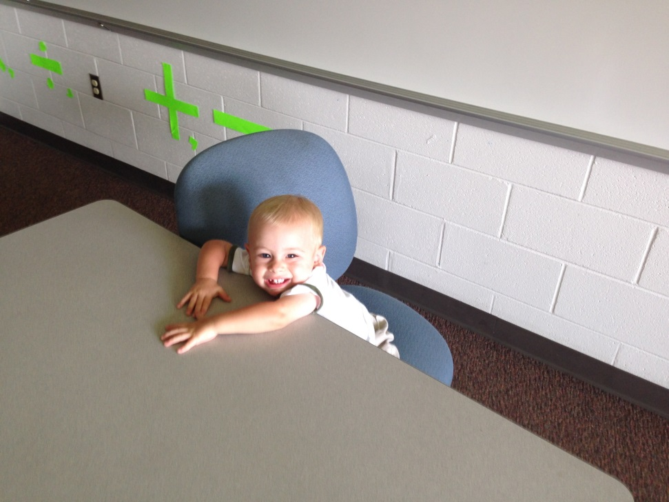
Who is Mr. Kramer?
I am in my fourth year teaching Sixth Grade Math at Woodlawn Beach Middle School.
I really enjoy teaching this course because the skills and understanding that students will gain this year are important foundations for college and career readiness

Slide 4

About Mr. Kramer
I am from Gainesville, Florida.
I went to the University of Florida, Go Gators!
My wife and I are expecting our 2nd child, a girl, on November 1 of this year.
We also have a 2 year old named J.D.

Slide 5

More About me
I am the JV Boys Soccer Coach at Gulf Breeze High School.
Last year I sponsored the math club here at WBMS and would like to again.
In addition to soccer, I enjoy outside activities and spending time with my family when I am not at school.

Slide 6
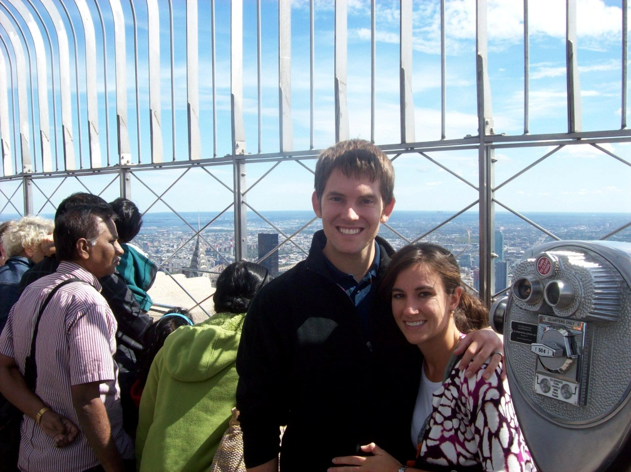
Last slide about Mr. Kramer
Before being a teacher I worked:
As a camp counselor
As a radio DJ
As a waiter
As a salesperson
And more…
I am passionate about math and I really enjoy my job as a teacher here at WBMS

Slide 7
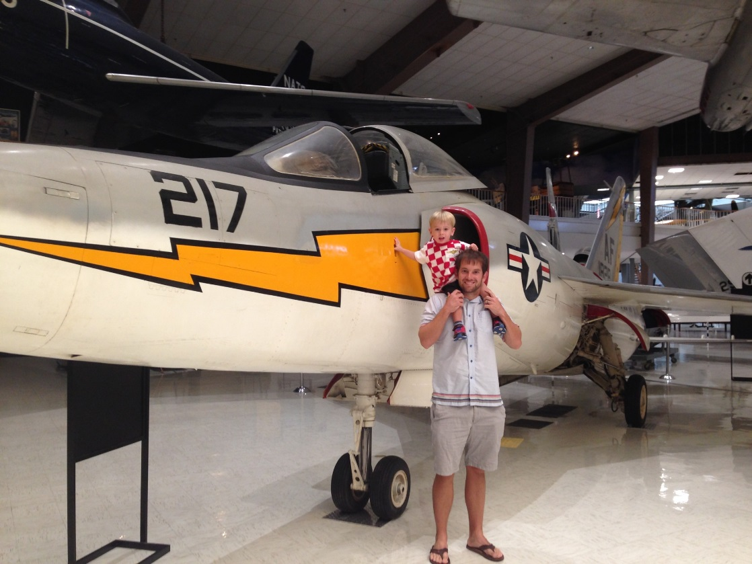
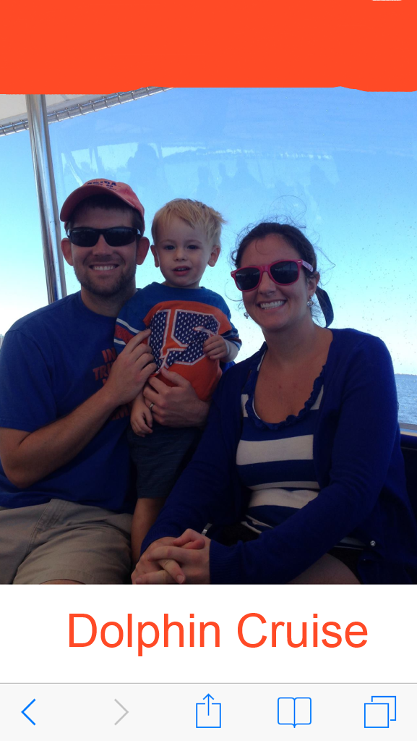
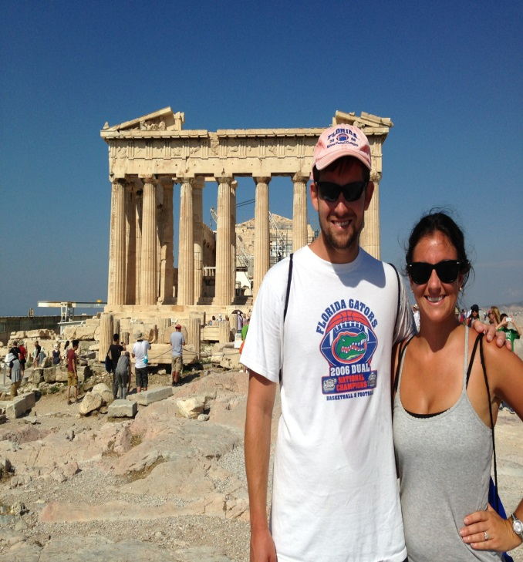
Over the summer

Slide 8
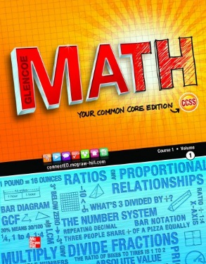
Sixth Grade Math Units
Six Grade Math will have 13 units.
We will start the year with the following units:
Unit 1 Ratios
Unit 2 Rates, including percent
Unit 3 Multi-digit computation and common factors and multiples
Unit 4 Dividing fractions

Slide 9
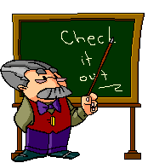
Sixth Grade Math Units
Unit 5 Representing relationships
Unit 6 Extending the number system
Unit 7 Relationships in the coordinate plane
Unit 8 Algebraic expressions

Slide 10
Sixth Grade Math Units
Unit 9 Understanding, writing, and solving equations and inequalities
Unit 10 Problem solving with area in 2-D shapes
Unit 11 Problem solving with volume and surface area
Unit 12 Understanding data distribution
Unit 13 Analyzing data

Slide 11
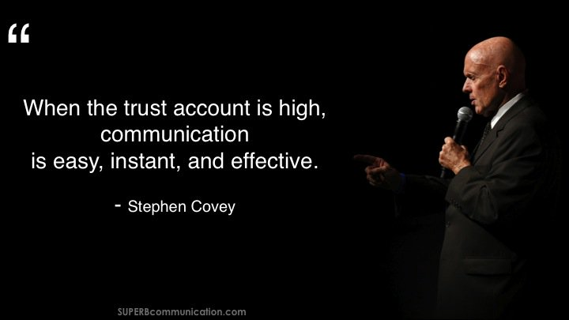
We are going to have a great year!
The teachers and students at this school are going to work together to achieve great things!

